Slide 1

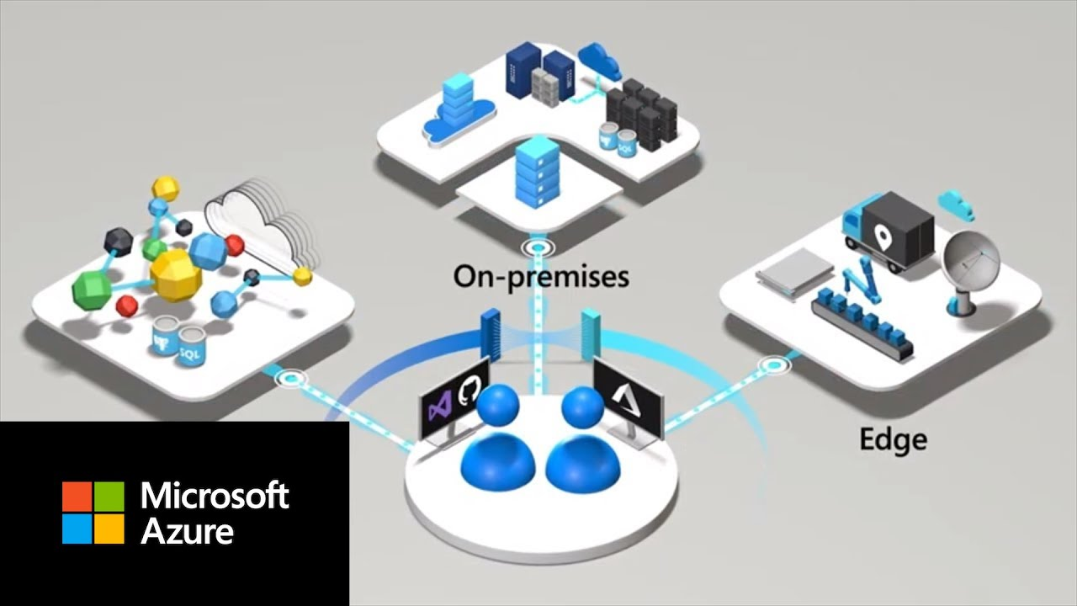
Azure Arc
By Shan CloudOps

Slide 2

Agenda
What is Azure ARC?
Fundamentals Behind this Service
Why should you use this Service?
Naming Convention for Different resources
Quick Walkthrough Microsoft Learn Page about Azure Arc
Quick Demo with Google VM to Azure Arc.

Slide 3
What do I mean when I say “Resources”
Physical machines in your on Prem Environment
Virtual Machines in your On Prem Environment
VM’s in Multi-cloud Environment
On-prem and Multicloud Kubernetes Clusters
SQL Servers
Edge- Azure Stack

Slide 4

What is Azure ARC???
“ Azure ARC is a Service or an offering in Microsoft Azure, which provides a Centralized Management of all the resources that exists in on-prem environment and multi-cloud environment”
“Azure ARC services are specifically designed to onboard Non-Azure resources to Azure”

Slide 5






Typical Enterprise

Slide 6
AWS-Console
GCP-Console
Console
Cluster Console
Azure Portal

Slide 8

What is Next??
It Can’t be just onboarding resources to MS Azure.
Or its can’t be just inventory Management?
“There has to be something beyond inventory Management”

Slide 9





Why will you use Azure ARC ??
ARC –Enabled Servers
Azure VM

Slide 10
Why will you use Azure ARC ??
Azure VM
ARC –Enabled Servers
1
Centralized Management Console
2
Deployment Of Extension
3
Onboarding Security Tools
4
Enabling Governance Needs

Slide 11


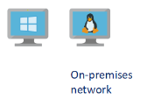





Connectivity Method – Azure Private Link
“Azure Private Link allows you to securely link Azure services to your virtual network using private endpoints. This means you can connect your on-premises Kubernetes clusters with Azure Arc and send all traffic over an Azure ExpressRoute or site-to-site VPN connection instead of using public networks.”
Azure Virtual Network
Extensions
Azure Policy
Guest Config
Azure Express Route
Azure Private Link
Azure ARC enabled Server Resources

Slide 12


Naming Convention
Major Services By Azure Arc..
Azure Arc Enabled Servers.
Azure Arc Enabled Kubernetes.
Azure ARC Enabled Data Services
Azure ARC Enabled Vmware vSphere
SQL Server On Azure ArC Enabled Servers

Slide 13


Slide 14

Reference
https://learn.microsoft.com/en-us/training/paths/manage-hybrid-infrastructure-with-azure-arc/

Slide 15

Thanks

